Slide 1

Applied Data Science Capstone
Project: Finding the best location in Toronto for setting up an office (HUB) for a food delivery company

Slide 2

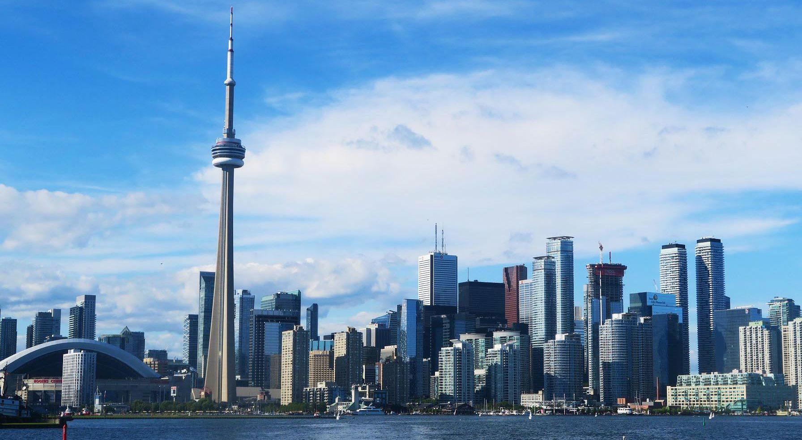
Introduction/ Business Problem
Lieferando is a Dutch dot-com company specialized in online food ordering and home delivery
They are planning to set up an office in Toronto to deliver foods from restaurants to home
They want to use Data Science to fin the best location for their office set up

Slide 3
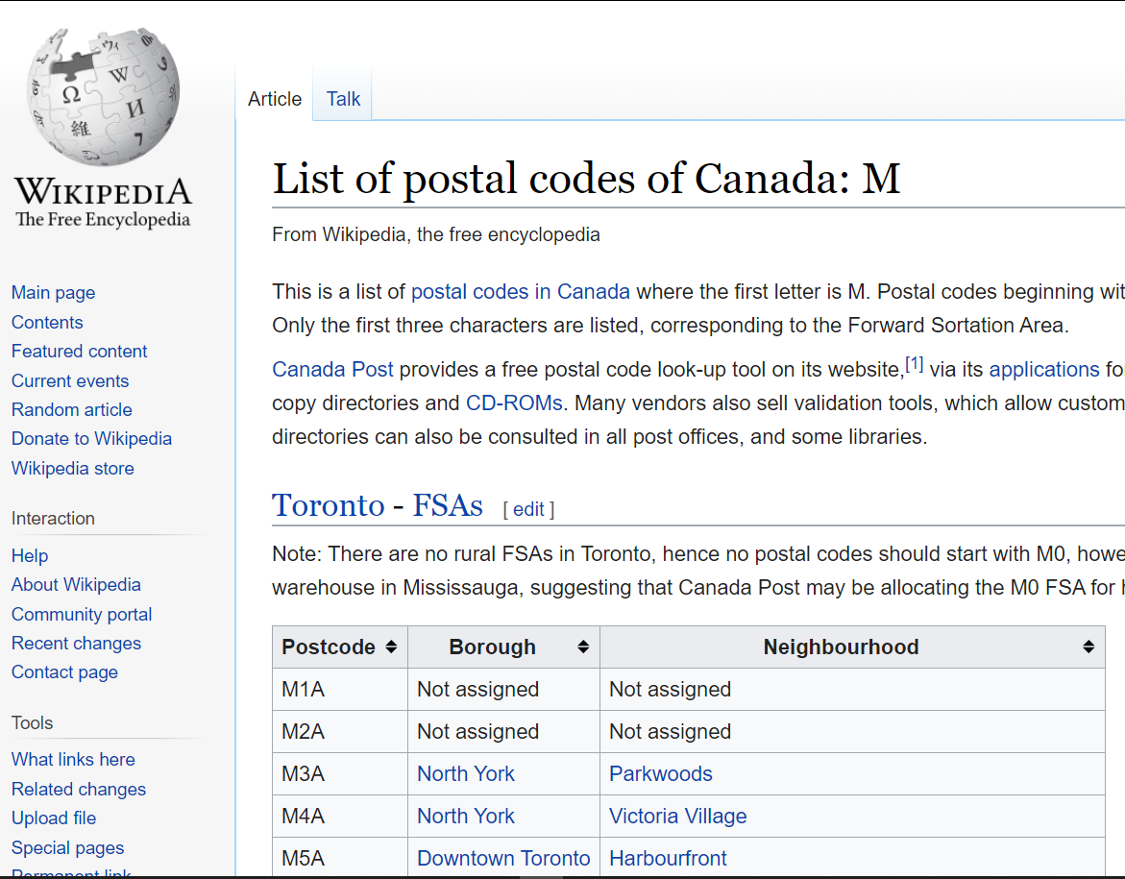

Data Collection
A list of postal codes in Canada where the first letter is M is taken from wikipedia.
Basic information of borough , postcode and neighbourhood is gathered from this webpage
(https://en.wikipedia.org/wiki/List_of_postal_codes_of _Canada:_M
The latitude and longitude coordinates of a given postal code is taken from this link (: http://cocl.us/Geospatial_data).
Information of neighourhoods of each postcode as well as borough in Toronto is taken from at Fourthsquare APi website (https://developer.foursquare.com/).

Slide 4
Methodology
The whole work is divided into three sections.
Step 1: Data importing and pre processing
Step 2: Using the Final DataFrame with FourthSquare API to extract maps
Step 3: Applying K-Means Clustering algorithm to cluster the restaurants

Slide 5
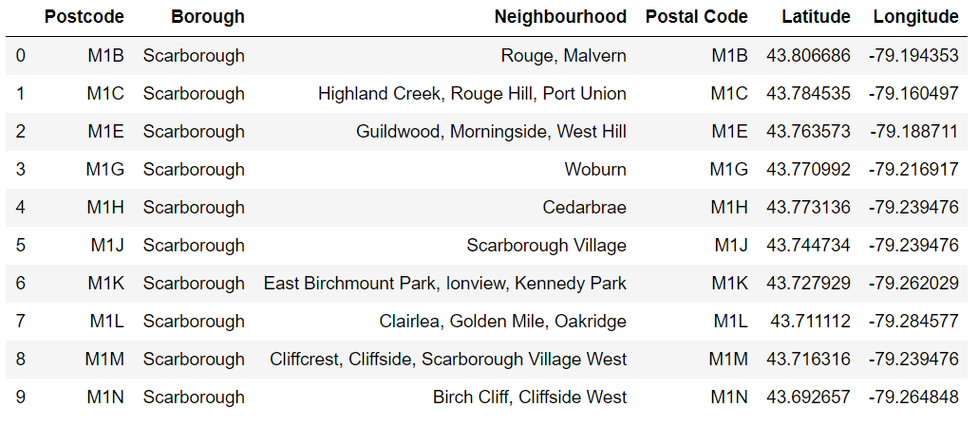
Methodology
Step 1: Data Importing and Pre Processing
The Latitude and Longitude columns of Geospatial Data is concatenated with our Toronto Postcode data frame. Final dataframe look like this

Slide 6
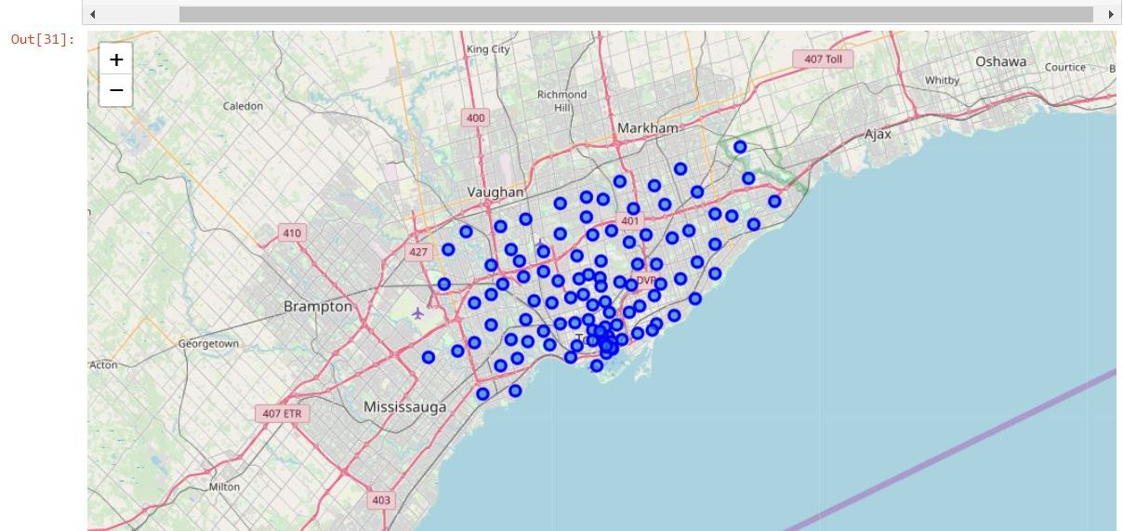
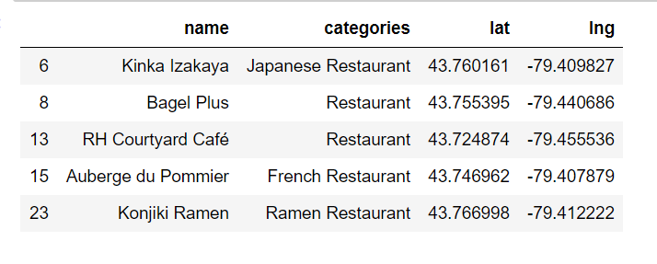
Methodology
Step 2: Using the Final DataFrame with FourthSquare API to Extract Maps
Then the dataframe is filtered by restaurant, since we need only the list of restaurants of North York
A map of Toronto with neighbourhoods on top is created.
This map shows neighourhoods of all the postcode
DataFrame is further processes to find out the borough of highest number of neighbourhood’s- which is found North York

Slide 7
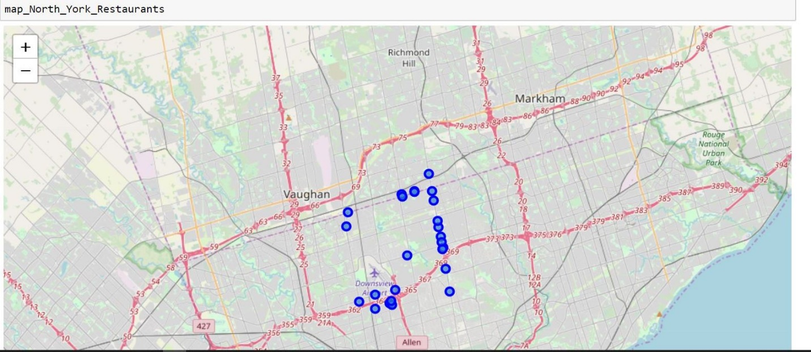
Methodology
Step 2: Using the Final DataFrame with FourthSquare API to Extract Maps
Then only the restautants of borough-NorthYork was created

Slide 8
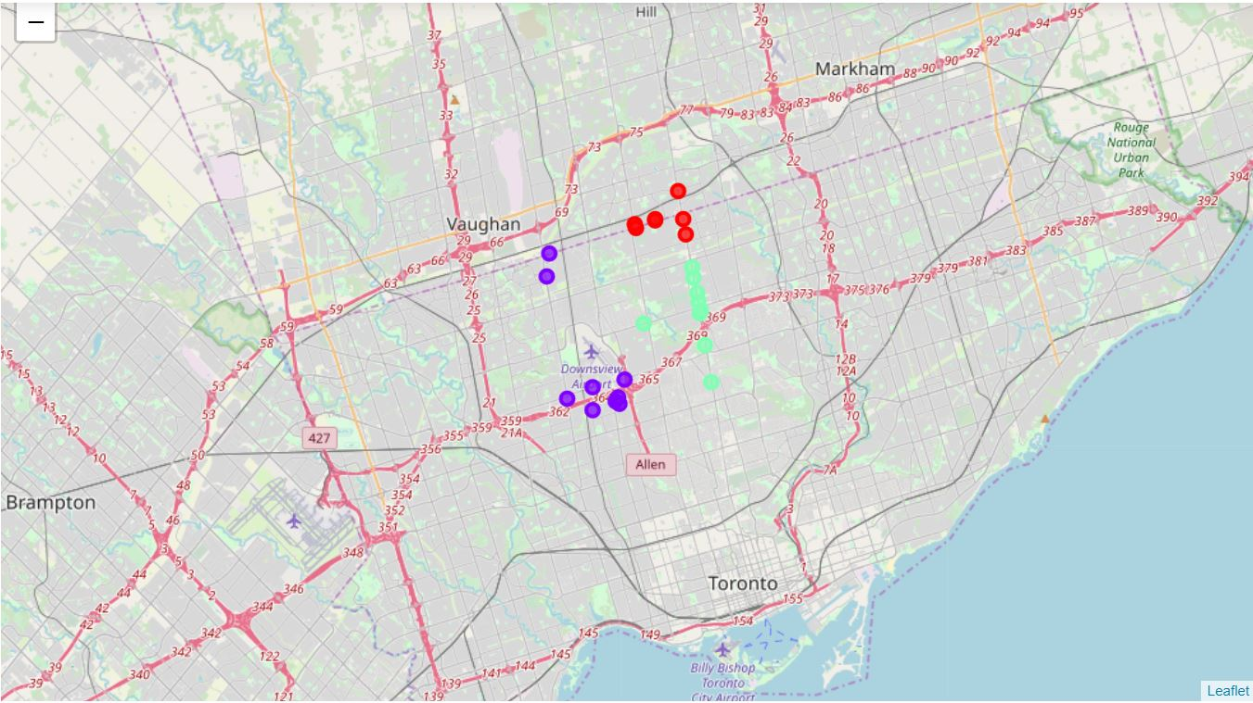
Methodology
Step 3: Applying K-Means Clustering algorithm to cluster the restaurants
After executing K-Means Clustering algorithm, the output was visualized on Toronto map using folium library

Slide 9
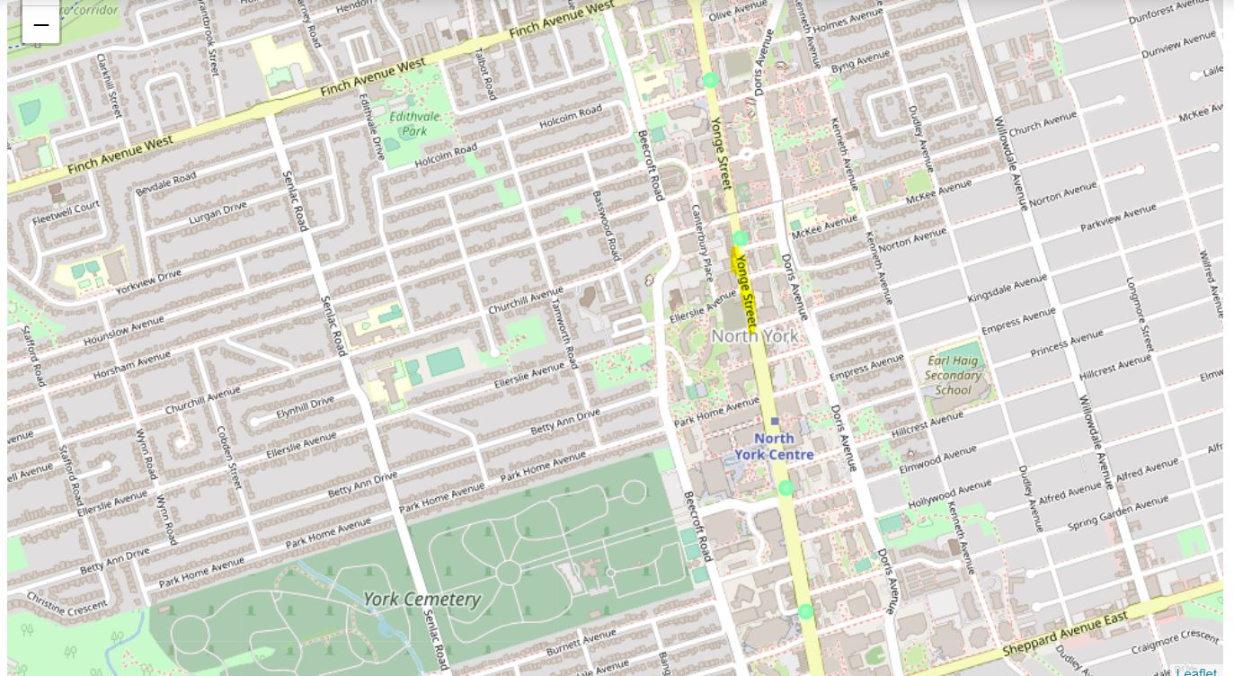
Results
If we zoom in we see that the location of green clusters is Yonge Street , North York. Even some of the red marked restaurants also Yonge Street.

Slide 10
Discussion
some of the data were lost while data pre-processing- which harms the project accuracy
If there were no limit then I might have got more list of neighbourhoods which finally would have helped to find more accurate results.

Slide 11
Thank you!

